Slide 1


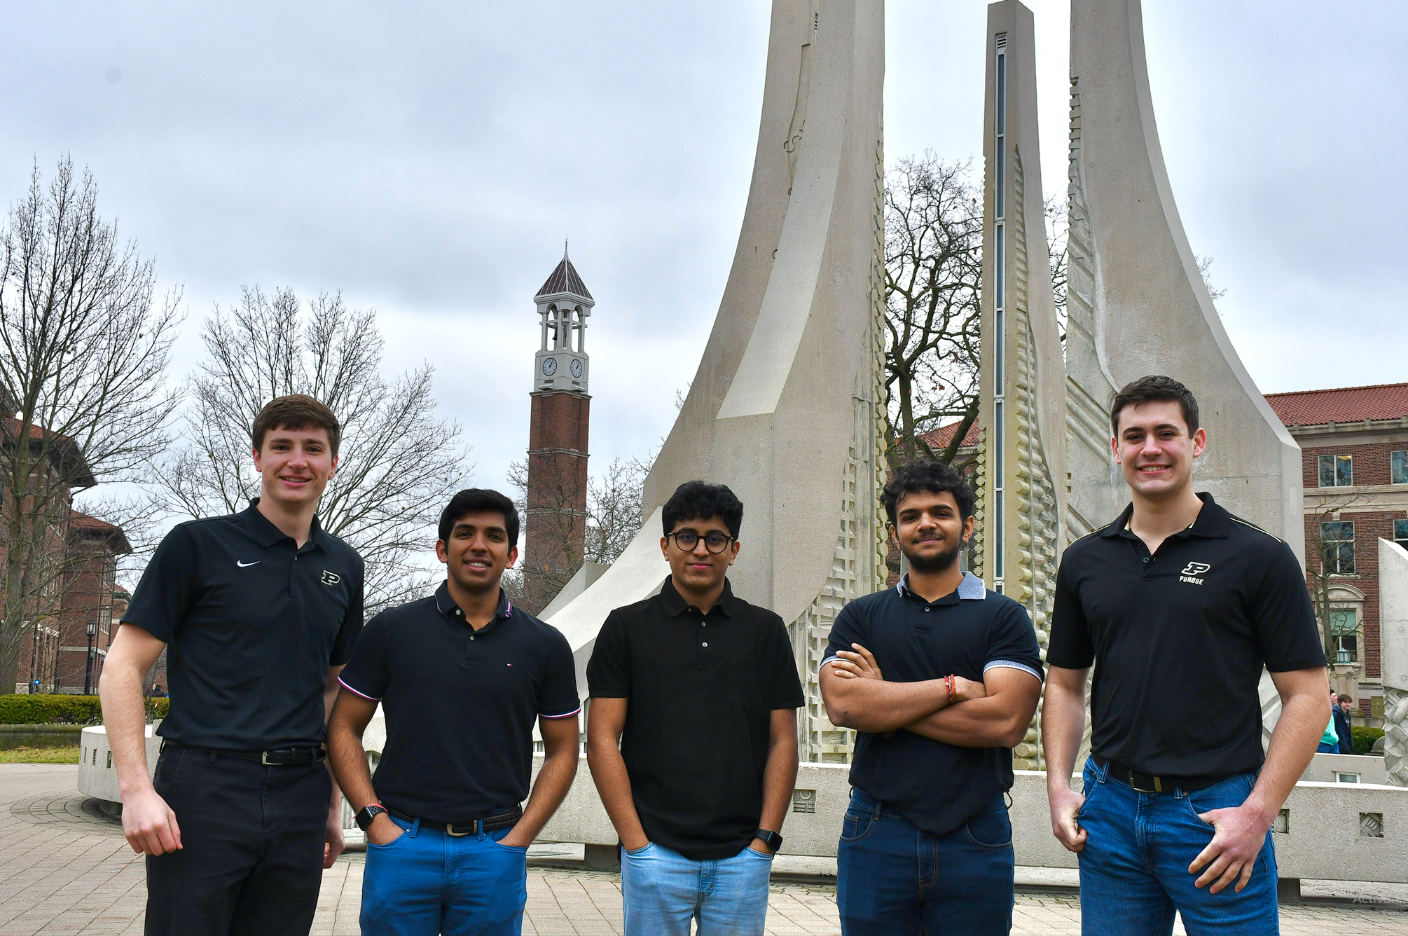






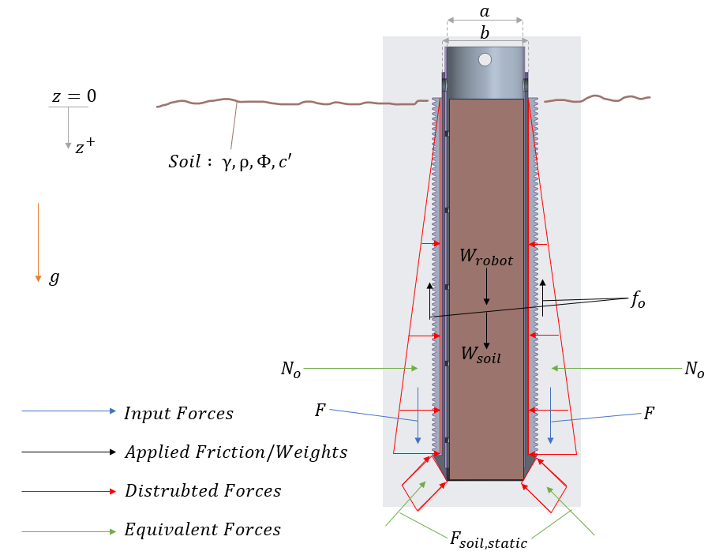


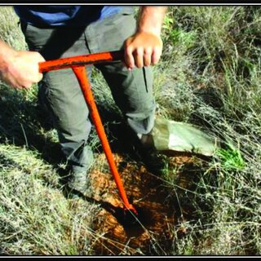
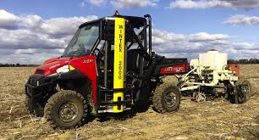
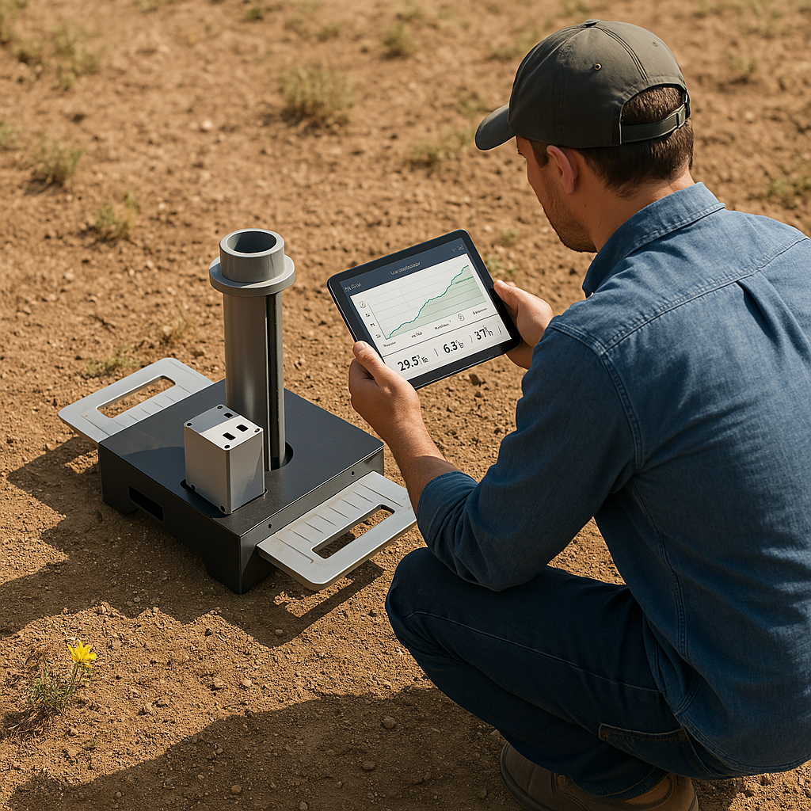
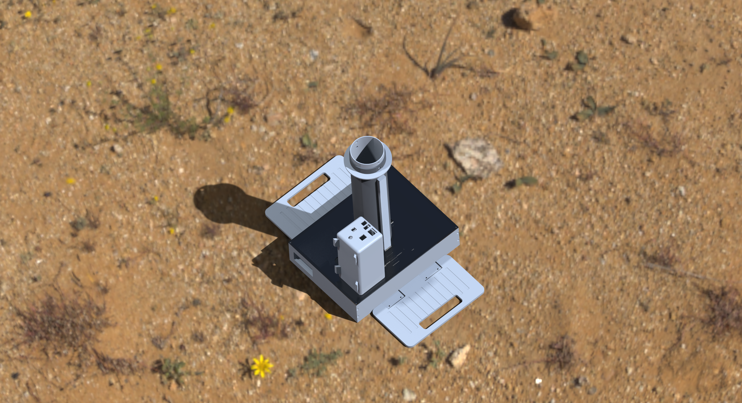
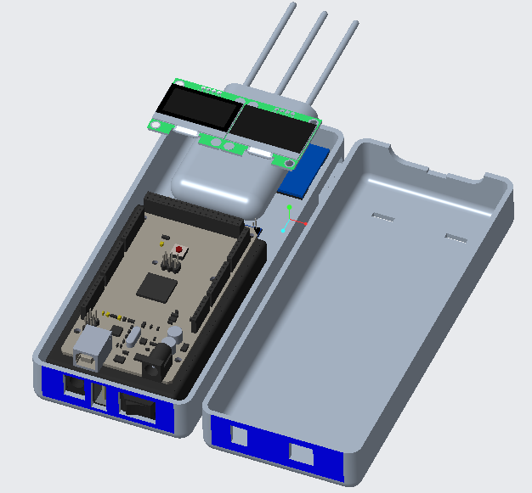
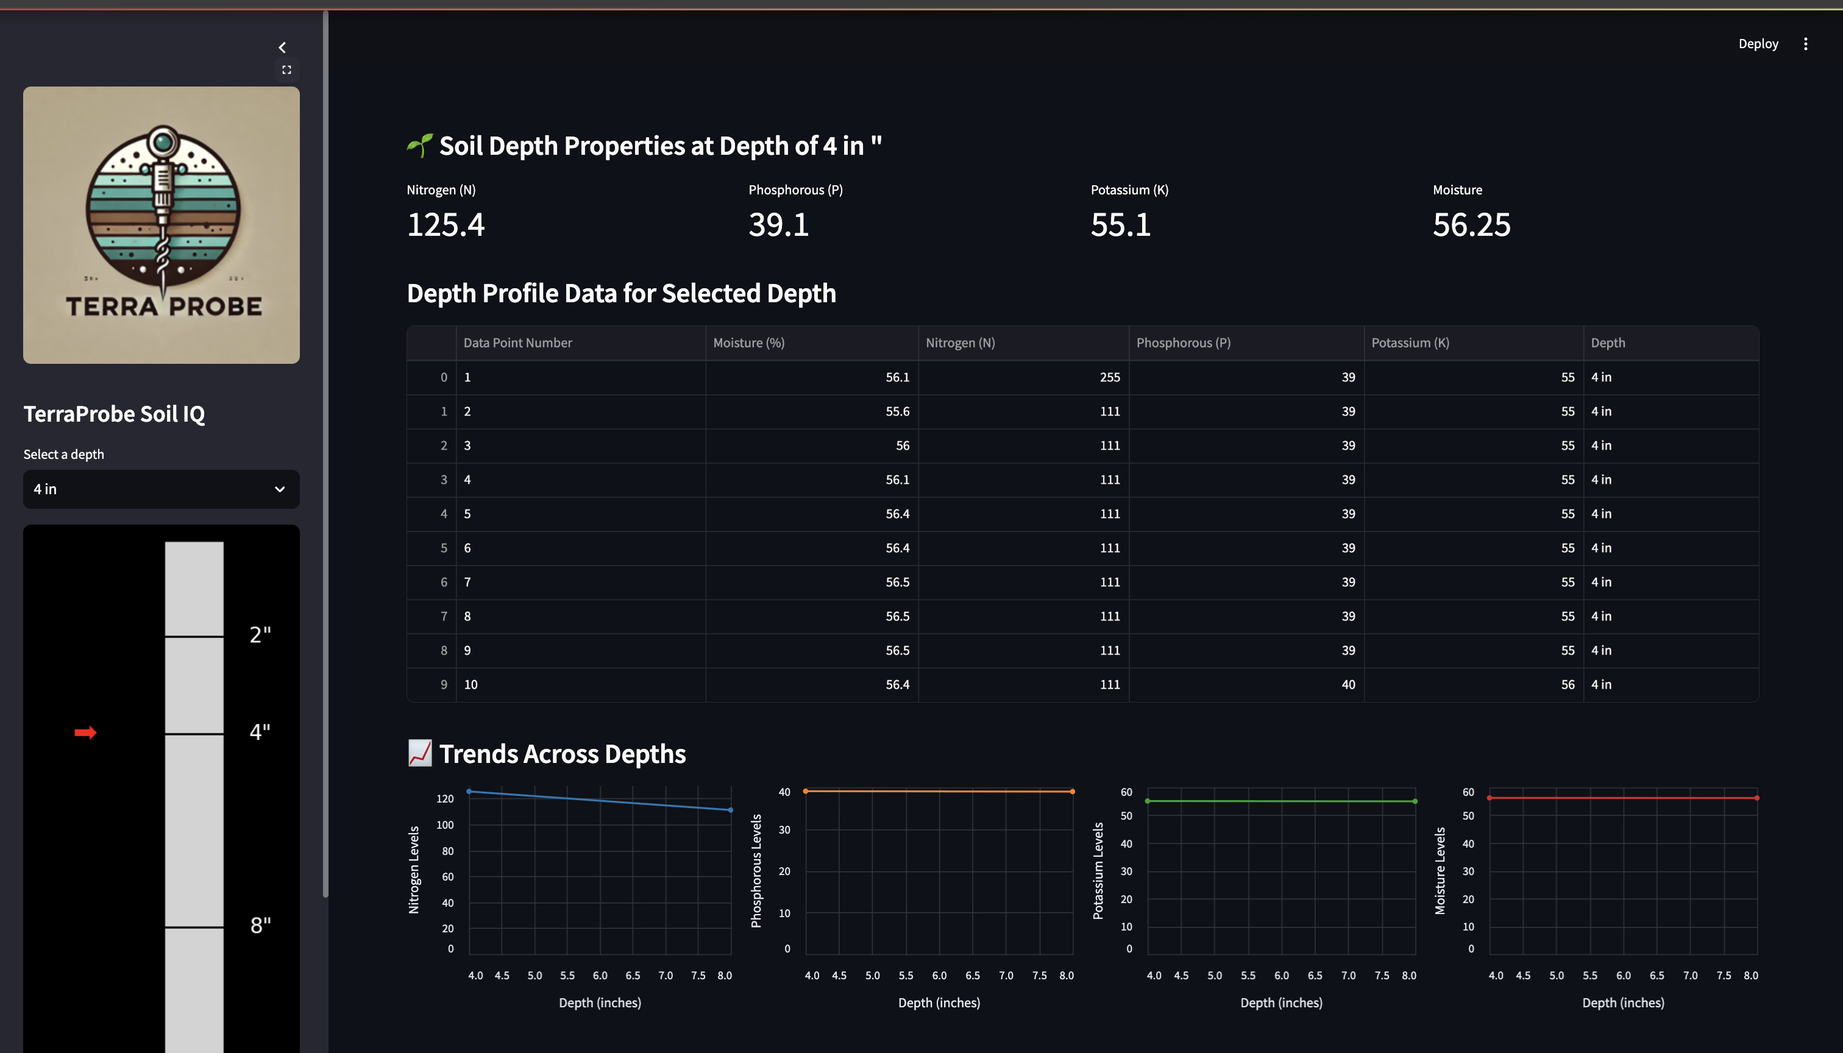


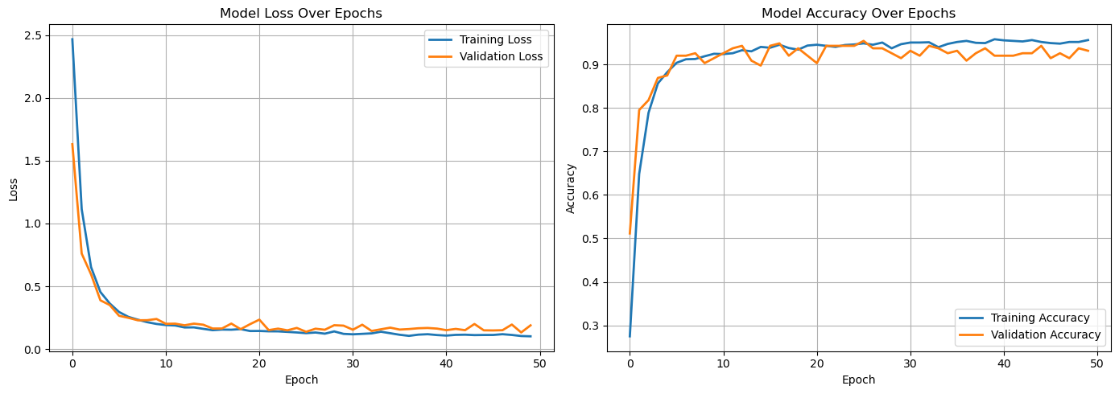



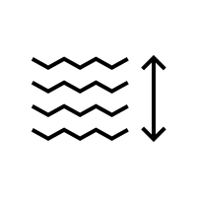









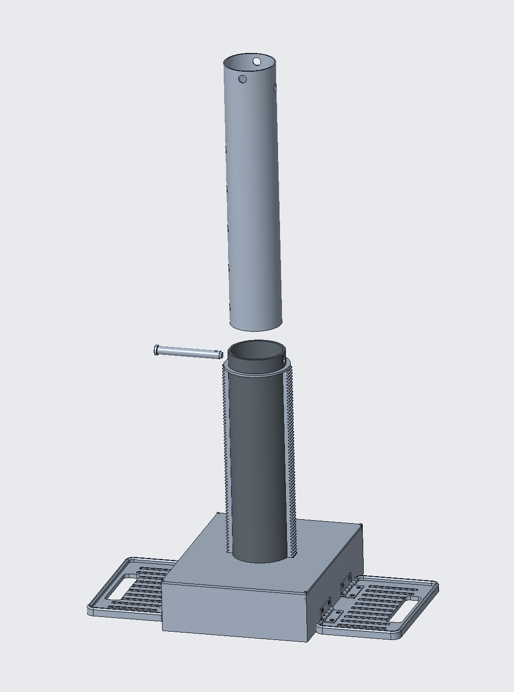
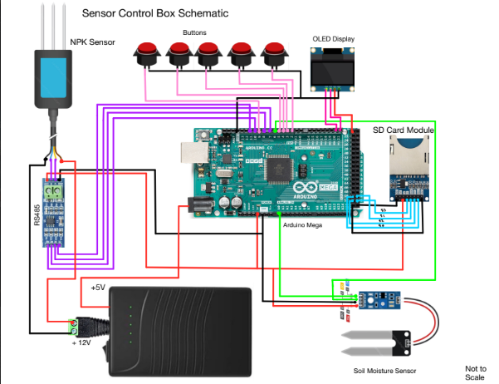



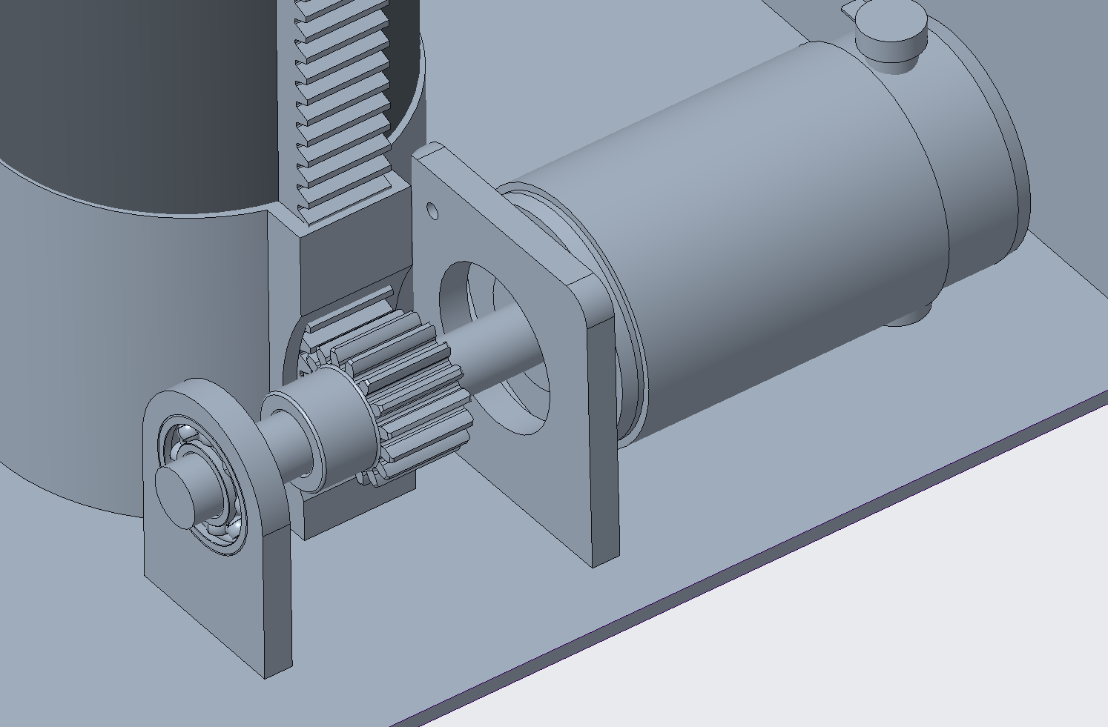
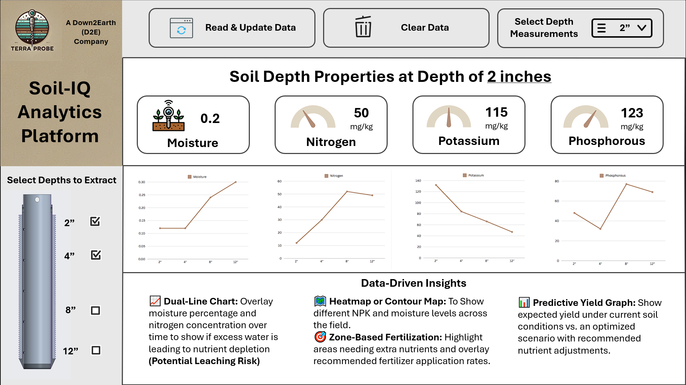
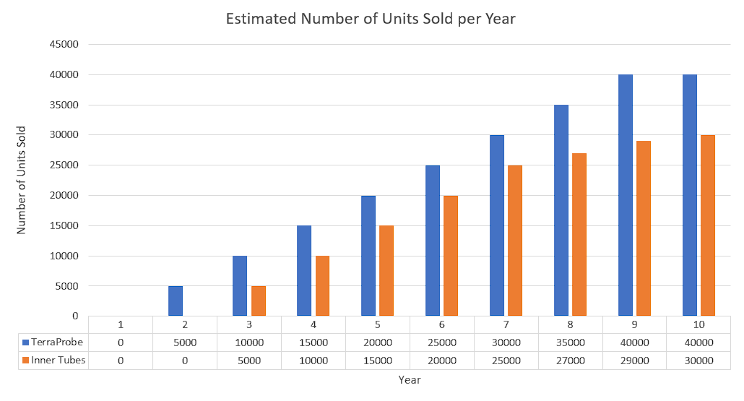
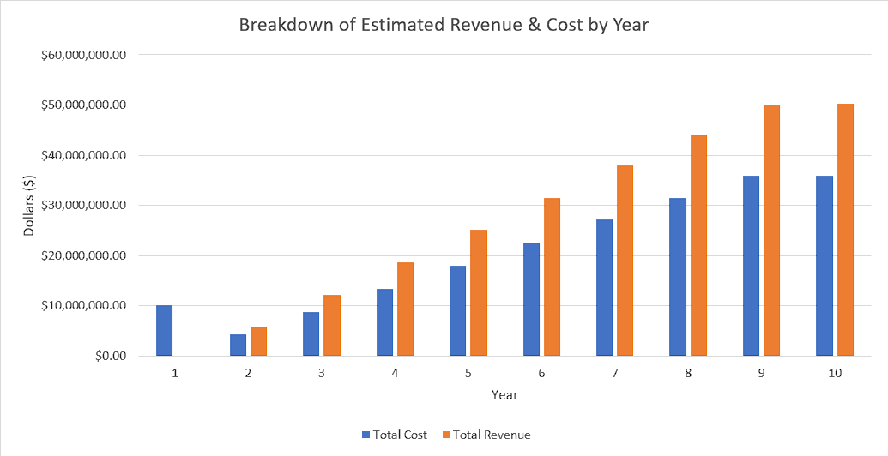
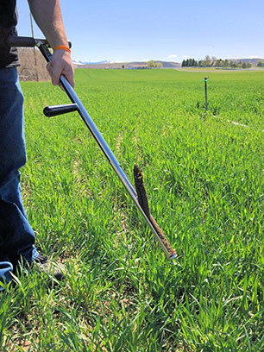
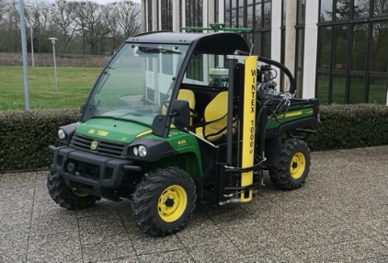
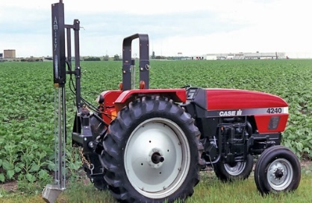

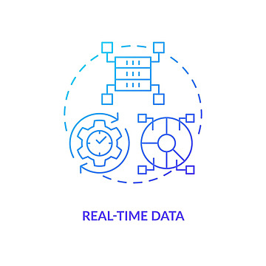

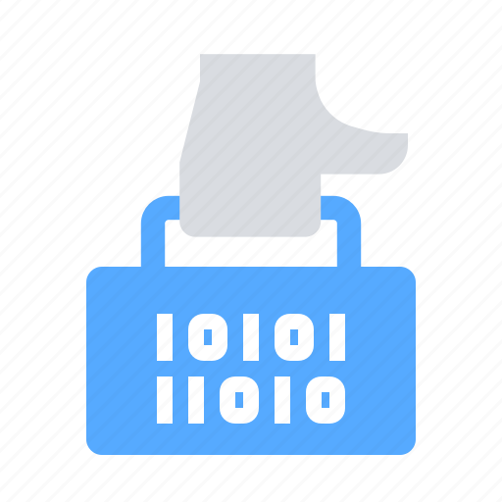
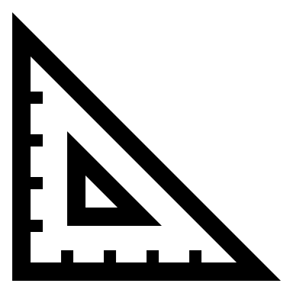
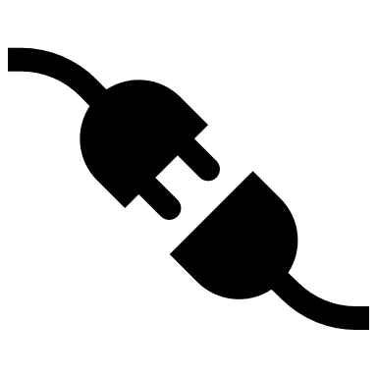




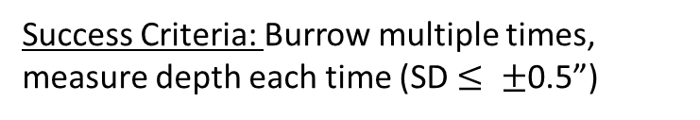
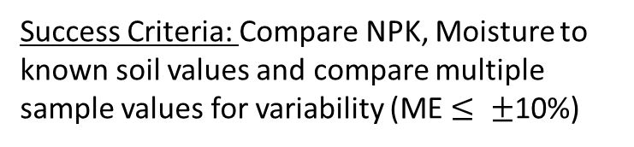
TerraProbe – A Down2Earth Company
Capstone Senior Design Project • Spring 2025
Down2Earth (D2E)
Revolutionizing Soil Sampling
Our Mission Statement
Current State
Future State
“TerraProbe aims to bridge the gap between manual probes and industrial sampling machines in the market, by offering an end-to-end connected experience through an automated, portable soil sampling solution with real-time data insights – allowing small/medium sized farmers to make informed decisions to improve crop health and yield.”
Chris Meyers, Sankaran Iyer, Avie Ghatge, Lokesh Sriram, Jacob McKenrick
Farming practices are evolving, but soil sampling remains outdated:
Intermediate solution that is affordable, automated, & actionable:
Simulation & Validation
Inconsistent Sampling & Contamination, No Depth Profiling
Portable, Affordable, & Lightweight Soil Sampling Solution
Introducing TerraProbe
Lab Testing of Soil Samples,
Lack of Real-Time Data Testing
On-Demand, Real-Time Data Dashboard
Soil Burrowing - Modelling & Simulation
Bulky, Manual, or Expensive Tools,
Lack of an intermediate solution
TerraProbe Soil Sampler
Soil Testing Probe (DAQ)
SoilIQ Dashboard
FBD Analysis
Used Rankine theory and soil pressure forces to estimate downward force needed for soil penetration
Simulation on Clay & Loamy Soil
Designed a 2-minute descent profile.
Required force calculated as 923.4 N for stiff cohesive soil
Motor Design & Sizing
Selected a 35W, 12V motor at 30 RPM
Validation & Testing
Tested on controlled soil field bed
Depth Consistency, Sampling Integrity (Tube fill, compaction), and Device Alignment
Multi-Depth Soil Core
Sampling & Depth Profiling
Critical Customer Requirements
Compact, Portable & Handheld Soil Sampling Device (9”x 12”x 17”)
Utilizes Rack and Pinion Mechanism for motorized power and downward movement (12” Deep)
Contains Replaceable Payload Tube for each sampling event
Sensor Module for on-site analysis capturing key parameters
Nitrogen, Phosphorous, Potassium (NPK)
Moisture
Readings taken at different intervals through slits on the inner payload
LED Display and Button selectors guides user experience
Digital platform to visualize NPK and moisture data at various depth profiles
Converts SD card data from DAQ into interpretable tables and charts
Utilizes neural network to predict and recommend potential crop type based on NPK, Temperature and Humidity Parameters
Soil Burrowing - Validation
Dashboard Recommendation Validation
Penetration Force Test
Success Criteria: Force to penetrate target soil types remains below motor torque limits (~923.4 N for stiff cohesive soil)
Benchmark Model(s) Limitations
TerraProbe’s Design Response
Burrow Time Test
High Cost ($3000-$6000)
Affordable ( <$1500 retail)
Success Criteria: Time that device reaches target depth (12 inches) is <= 2 min in loamy soil
Crop Recommendation Dataset
Kaggle dataset augmenting rainfall, temperature, humidity, and NPK data
Neural Network Loss Function
Low training and validation loss indicates high accuracy and generalizability of dashboard recommendations
Model Accuracy: 92% (Train-Test-Split)
Bulky, Difficult to Transport
Compact & Lightweight (<25 kg)
Depth Accuracy Test
Manual or Complex to Operate
Automated Operation & Burrowing
Engineering Details & Function
Success Criteria: Burrow multiple times, measure depth each time (SD $≤ ±$0.5”)
Inconsistent multi-depth sampling
Multi-Depth 4-layer sampling (up to 12”)
Sensor Accuracy Test
No integrated data analytics
Testing Probe & Data (NPK & Moisture)
Success Criteria: Compare NPK, Moisture to known soil values and compare multiple sample values for variability (ME $≤ ±$10%)
Partially Exploded View – TerraProbe Soil Sampler
Soil Testing Probe (DAQ) Electrical Diagram
Market Potential & Opportunities
Shell & Payload
Shell (outer tube) is welded to the racks
Payload (inner tube) houses soil
Rack & Pinion Mechanism
Dual 12V DC motors power downward moment
Foot Pedals
Adds grip, stability, and easier insertion of payload
DAQ Electronics Architecture
Arduino Mega 2650 for control
SD Card Module: Logs data
LED Display: Real-Time Feedback for User
Battery Powered for Portability
NPK & Moisture Sensors
Financials: Prototype to Product
Primary Focus
Global Soil Testing Market: $5.5 Billion (2023)
Revenue Streams
Hardware Sales
Consumables & Replaceable Parts
Software & Data Services
Sensor Testing Probe
Base Unit (TerraProbe Device)
Inner Payloads
Maintenance (Potential Revenue Stream)
Basic Dashboard Access (Free)
Predictive
Analytics
Production Cost
Sell Price & Margins
Number (#) of US Farmers: ~1.8 million
TerraProbe → $832.93
Inner Tube → $84.24
TerraProbe → $1050
Inner Tube → $130
Software → Annually $100
Agricultural
Number (#) of Small-Mid Acreage Farms: ~670K
Motor-Pinion-Rack – TerraProbe Soil Sampler
Soil IQ Dashboard System
Production Cost
10-Year ROI
Secondary Focus
Target Market Adoption Rate: 20% (conservative)
Motor Driver System
Controls power and direction (12V, 35W, 30 RPM Motor)
Bearings
Prevents failure due to excessive stress, misalignment, or wear
Backend & Interface
Built with Python + Streamlit
Data Processing
SD card data -> Pandas DF
Predictive Analytics
NN predicts best crop based on soil properties
$50M
33%
Target Addressable Market (Units): 134K
Research
Construction
Goal: Capture 20% of Market Over ~10 Years
Competitors & Market Gaps
Innovation & Benefits
Future Iterations & Considerations
Low to High Complexity
Variable Depth Sampling
Plug & Play Modular Sensors
Enable programmable depth control
Attach/detach multiple sensors for testing (Modular)
AMS Soil Probe
WintexAgro 1000
Amity Technology
Multi-Soil Adaptability
Connectivity & Analytics
Low Cost & Portable
Automated Sampling
3rd Party Data Analysis
Automated Burrowing & Multi-Depth Soil Profiling
Data-Driven Decision Support
Affordable & Efficient
Portable & Lightweight
Motor speed control knob for torque control
Bluetooth communication for real-time data and additional predictions/recommendation analytics
Manual, No Data
Vehicle Mount, Heavy
Heavy & Expensive

